Slide 1
GANs Code and Output
Soham Sarkar 18BCE1016

Slide 2
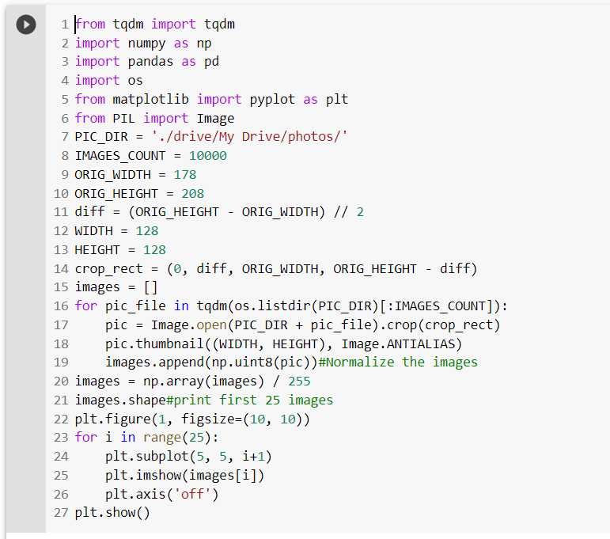
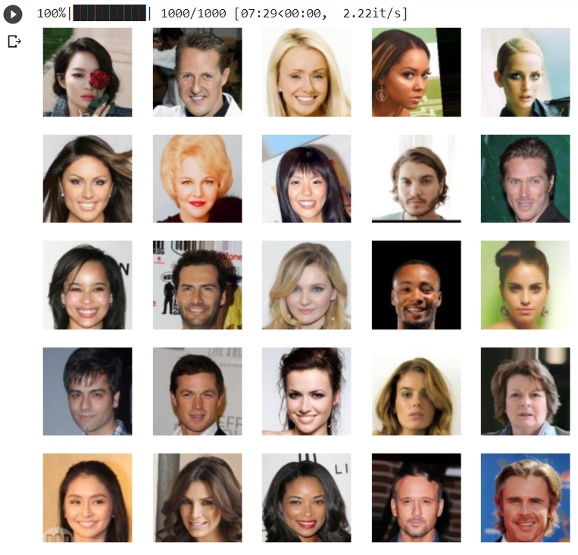
Code for face generation using GANs
Accessing ‘photos’ folder from Google
drive and printing the first 25 photos.

Slide 3
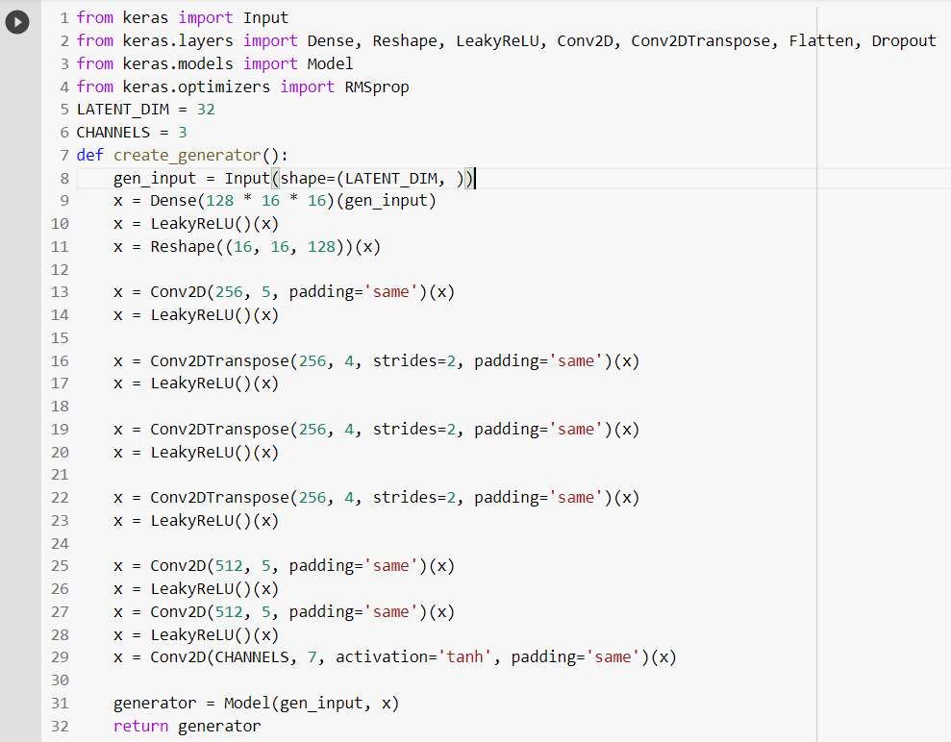
CODE contd…
Code for generator

Slide 4
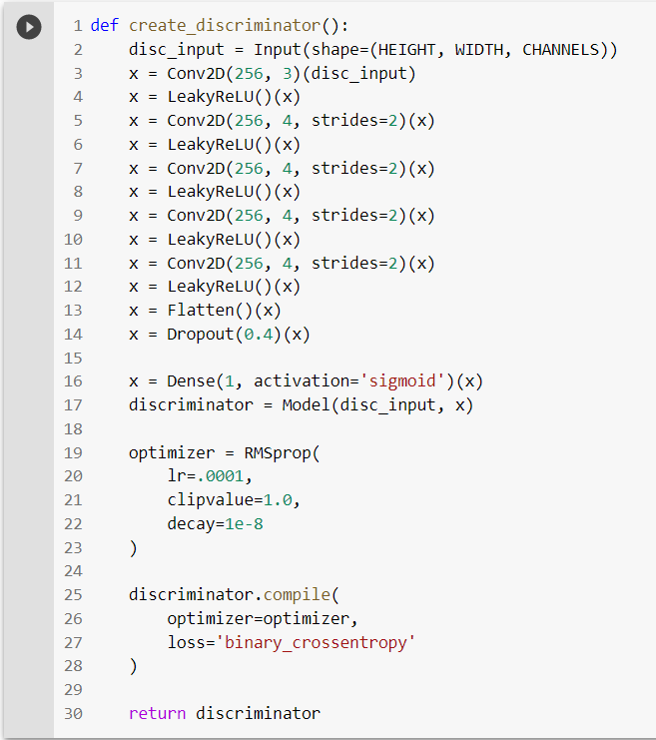
CODE contd…
Code for discriminator

Slide 5
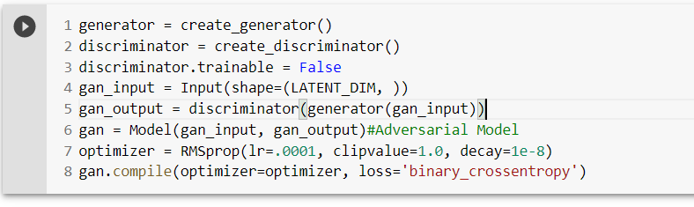
CODE contd…
Defining the GAN model

Slide 6
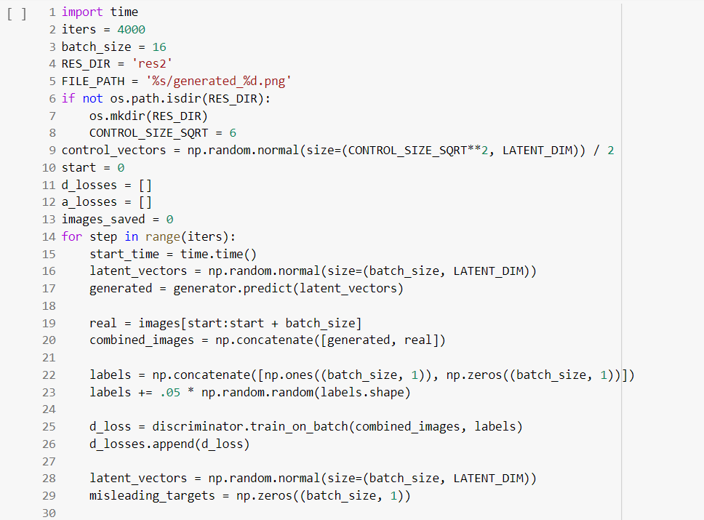
CODE contd…
Training the GAN

Slide 7
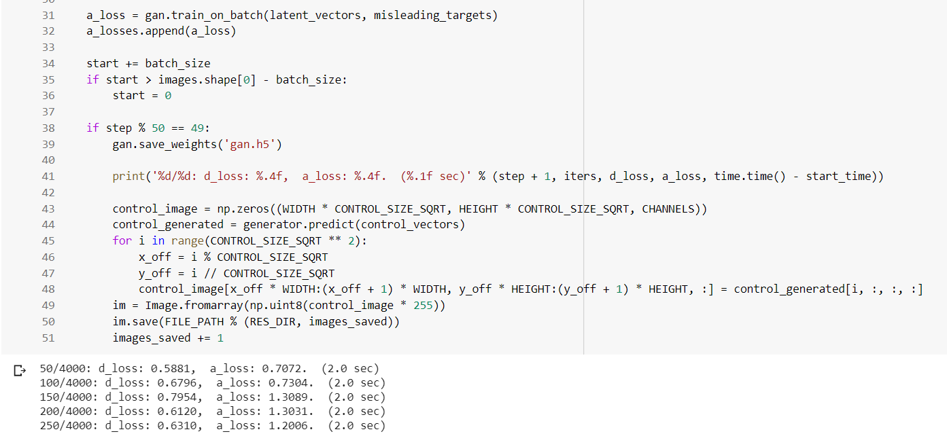
CODE contd…

Slide 8
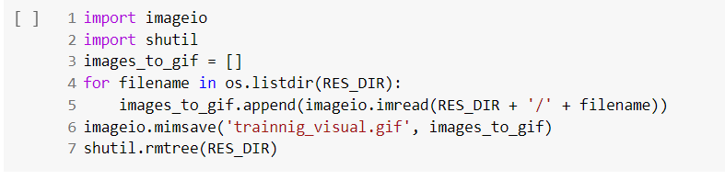
CODE contd…
Converting the output into a gif

Slide 9
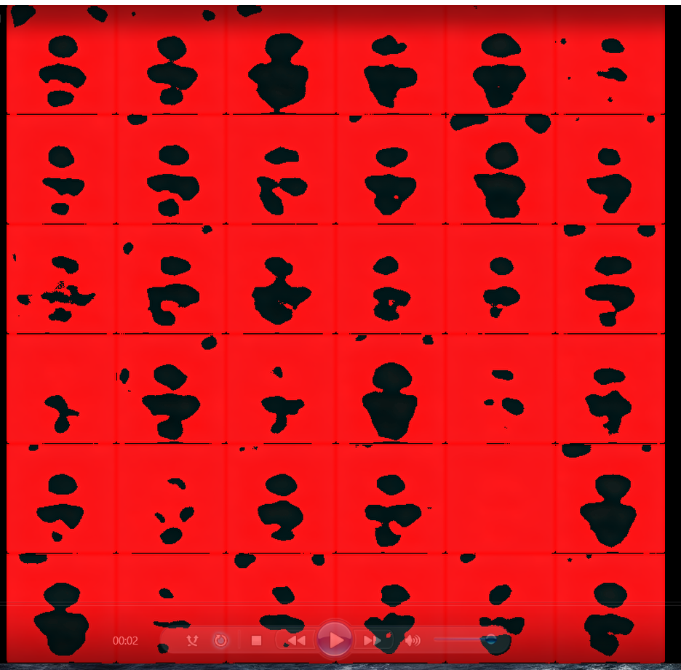
Output
500 images and 100 epochs

Slide 10
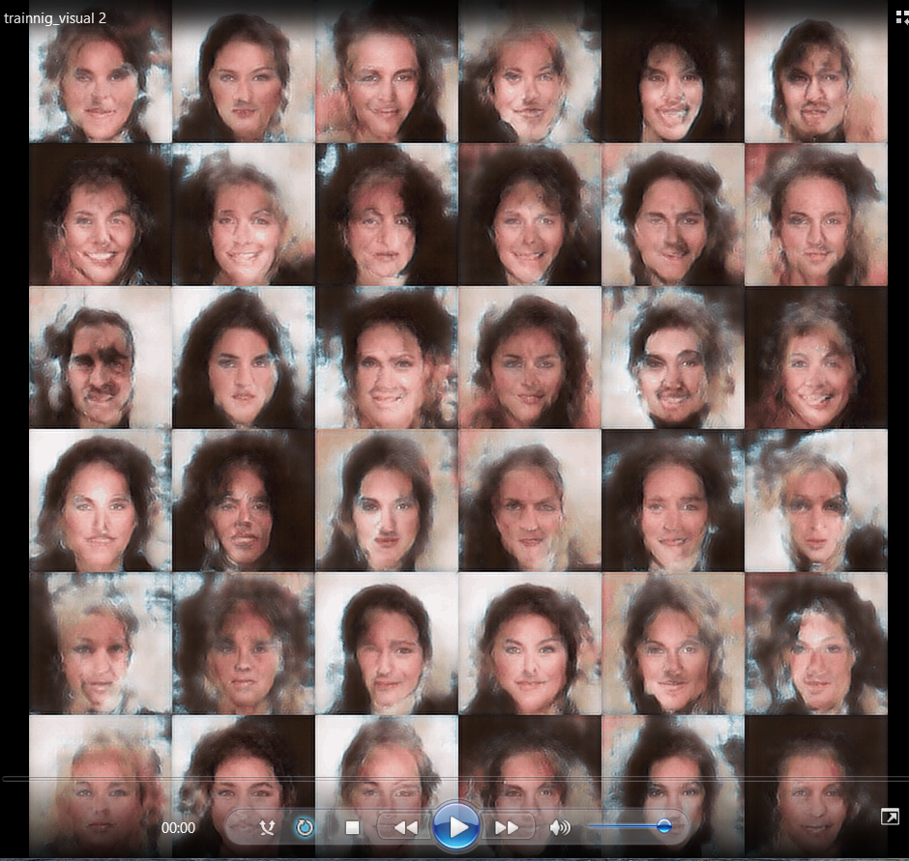
Output
500 images and 2000 epochs

Slide 11
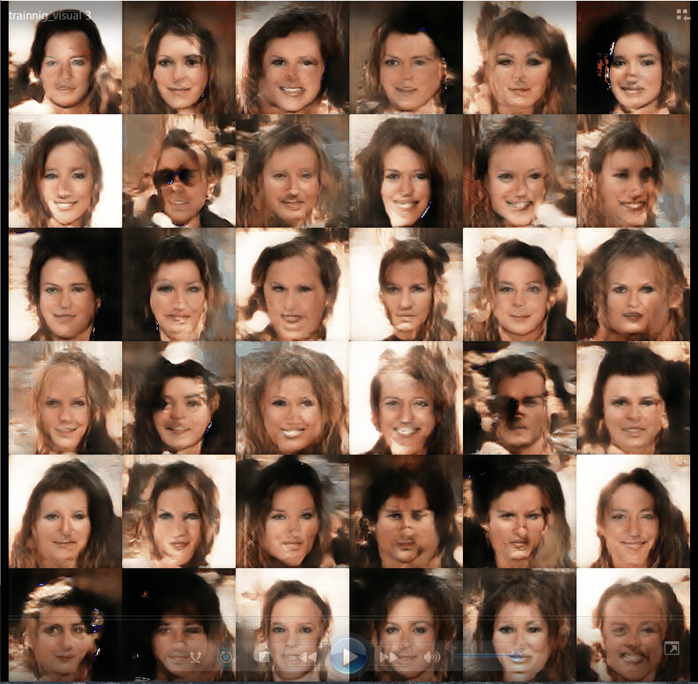
Output
1000 images 4000 epochs

Slide 12
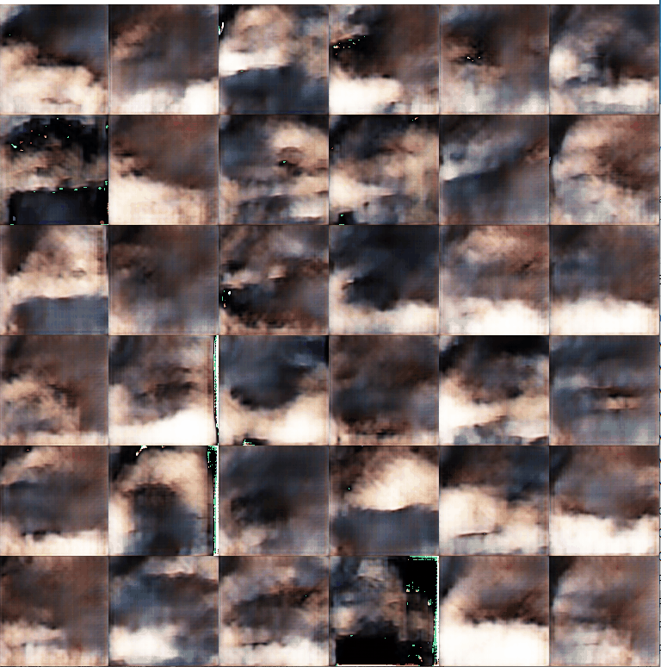
Output- Masked Dataset
400 images X 3000 epochs
Dataset has images of varying
sizes, so output got distorted.

